Slide 1
LIVE-IN CARS
Team Neon :
Hasan Ali Mirza
Mohammed Mubeen Ahmed
Sai Harsha Potluri

Slide 2
INTRODUCTION
Automobiles have become a basic need for people these days. We cannot assume a world with mobility automation these days. Not only cars, motor cycles but also most futuristic mobility products started making their way in to market. We can see many automakers are making huge money banks with the booming market for automobiles. So, we as a team decided to design a money making web application which targets all automobile users to have a look.

Slide 3
CURRENT APPLICATIONS
These are many applications regarding auto service and selling auto parts online. Basically, they perform marketing activity for their respective physical service centers. They provide customers all the information regarding available services, offers and enable them to schedule appointment to take their car to service station.

Slide 4
PROBLEM
The number of people who purchase cars or any sort of automobile has been increasing on a higher growth rate. So, the requirement for auto servicing and selling auto accessories had gone up. But, we felt in the modern world taking out your car to service station is an old idea. Now we are taking this business a step ahead with our proposed application

Slide 5
PROPOSED APPLICATION
For us, making business out of our application had been the focus. Of course may not be now but sometime in the future. Now, we are designing a web application similar to amazon. Here you can select accessories/services and purchase them. Once you confirm your payment, you get your items delivered at your door step. If you needed any sort of service like oil change/tire installation, our service on wheels team will perform service at your place. Basically, we assure all your car needs fulfilled with a simple application

Slide 6
TARGET USERS
For our proposed application, this can be a very simple and single line.
“EVERYONE WHO HAS GOT A CAR IS OUR TARGET CUSTOMER”

Slide 7
USER GOALS
Every user who visits our web application looks for quality accessories and quick service. He will be looking for easy and comfortable navigation through pages. He also looks for simple and attractive design. So, that he should be relaxed and hassle free with using application. He should have the ultimate goal of sorting out his required items and service and finalize his payment without any difficulties.
His goals can be properly achieved by designing an efficient web application. Proposed application is much simpler and easily navigated from one page to another. Load time of website is also very low which does not frustrate the users to wait while looking or checking out their products

Slide 8
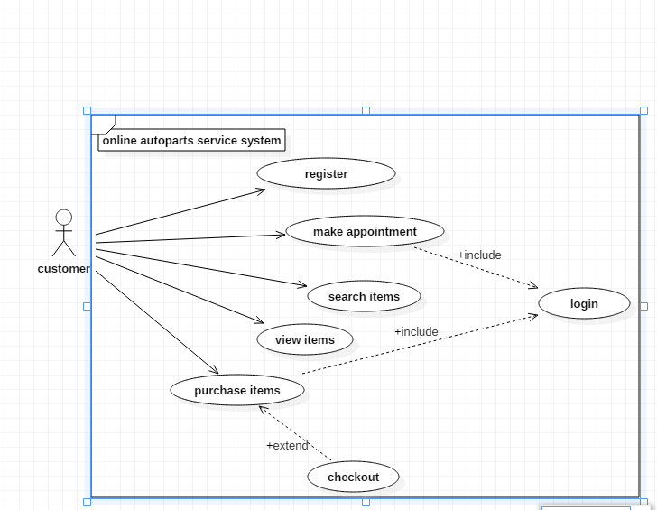
USECASE DIAGRAM

Slide 9
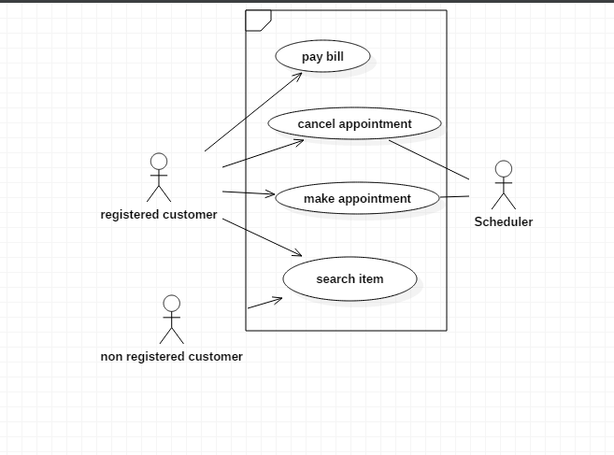
Use Case Diagram

Slide 10
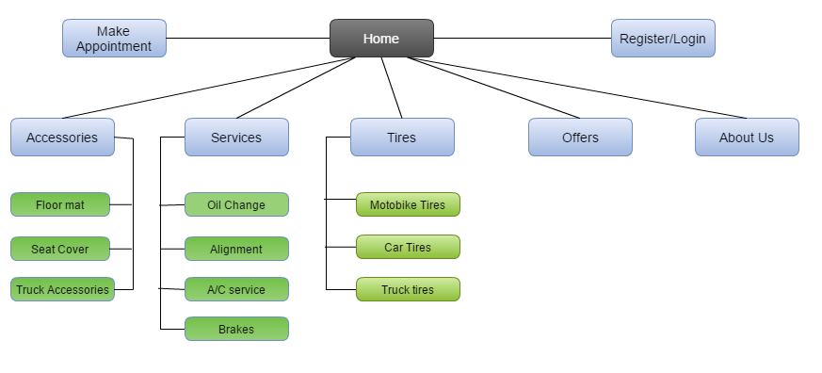
INFORMATION ARCHITECTURE SITEMAP

Slide 11

LAYOUT DESCRIPTION
We, have selected and finalized a unique logo for proposed web application. So, all our pages and their color patterns are going to be on song with the logo.
Below is our logo:

Slide 12
Page coloring:
So, now page coloring for proposed is going be striking and pity much in relation with finalized logo. The complete coloring image of application can be assumed, once you look at the attractive logo.
Headers:
We are working on keeping headers similar throughout the pages. It should be highlighting the page you are navigating. Team is working on the proper alignment of functionalities/modules and other pages.
We are looking at headers somewhere similar to below image:

Slide 13
Footers:
Footers related to this application are going to be very simple look wise. But still we are looking at fully functional footer. It may include some functionality like “like us Facebook etc.” It will also provide a gateway to any other page at any point of time.
Use of graphics:
Using high quality graphics can be an added advantage to this kind automotive web application. We are looking at implementing these graphics to images and car related stuff as per the functionality requirement.
Others:
All other pages like cart, book appointment etc. are much focused on performance rather designing and color aspects. But, our team is anyhow focusing on bringing out an appealing look to the all pages of the application.

Slide 14
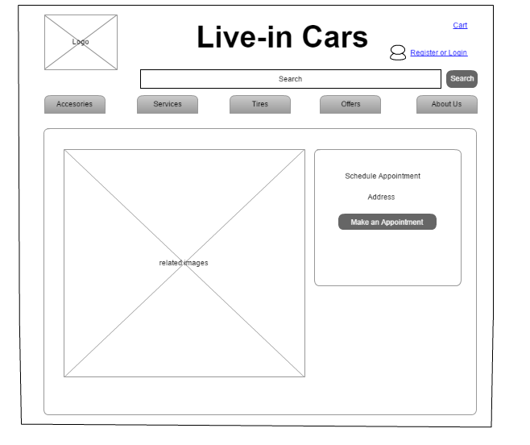
WIREFRAME
HOMEPAGE

Slide 15
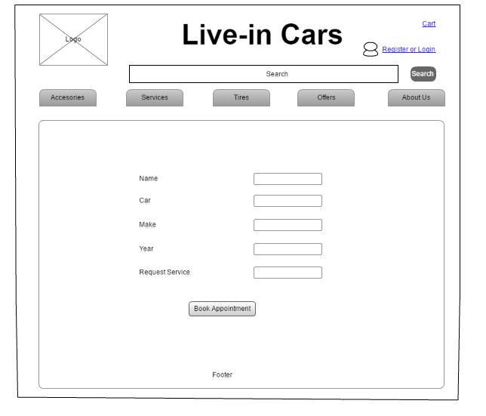
APPOINTMENT

Slide 16
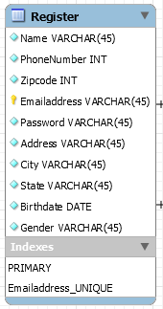
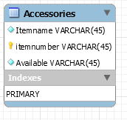
DATABASE TABLES

Slide 17
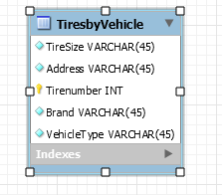
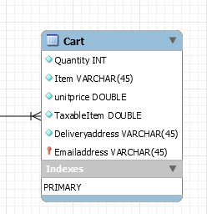
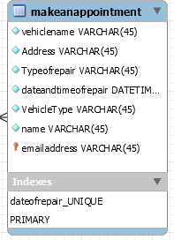
DATABASE TABLES

Slide 18
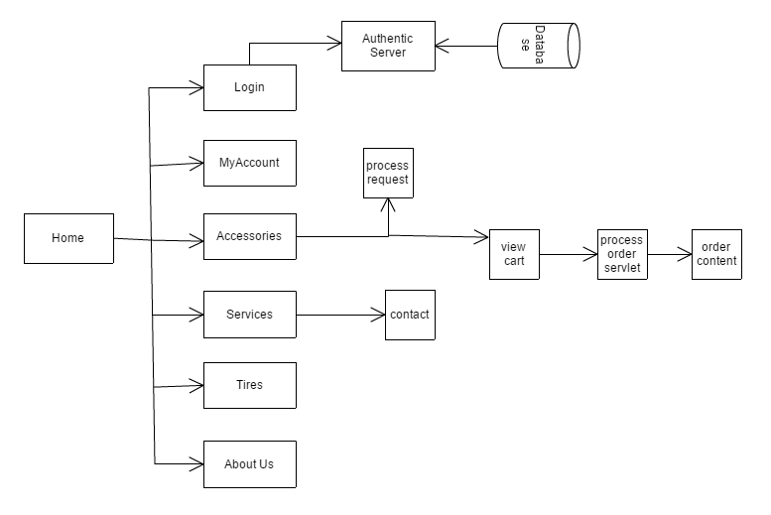
BLOCK DIAGRAM

Slide 19
modules
REGISTER
ADMIN LOGIN
LOGIN
MAKE AN APPOINMENT
PRODCUTS
SERVICES
MESSAGE CENTER
SEARCH
CART
PAYMENT
ABOUT US
CONTACT US
DOCKS

Slide 20
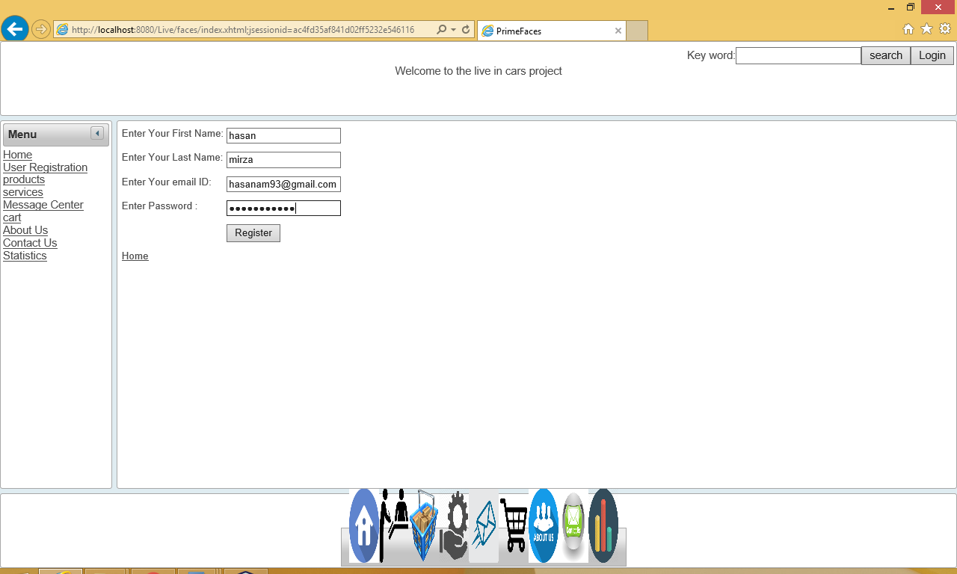
Register module
This module is the very first one, a user looks at. It is quite simple to understand and perform. It allows any user to get registered with our application. Now, user can go ahead with his specific tasks. He can get into application completely and use its full functionalities. He will simply need to provide his first name, last name, email and select a password.

Slide 21
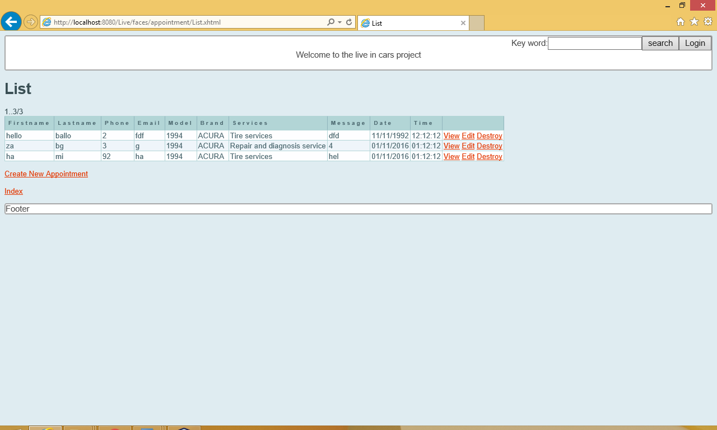
Admin login
This is a simple and useful part of our application. This is much needed for business to get carried forward. The person who handles the business will act as admin to the application. He will get a proper id/password from developers’ side. He can use it to get into application. He can view the scheduled appointments and accordingly.

Slide 22
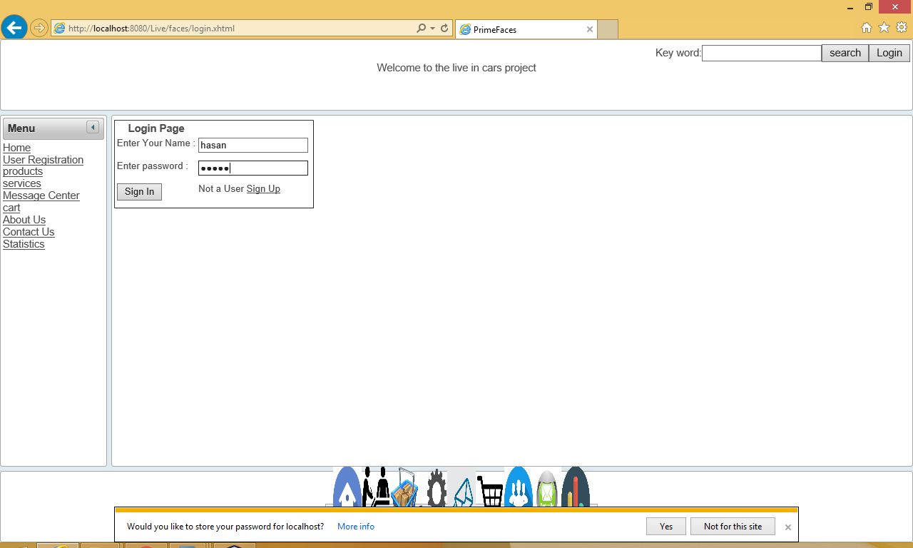
Login module
This is quite similar to that of our “register module”. Say, a user gets registered to our application using “register module”. Now he needs to get logged into the application using this login module. To make it simple, the register user will have drop down his id/password here to enter application. Once, he hits correct, he is into the world of cars.

Slide 23
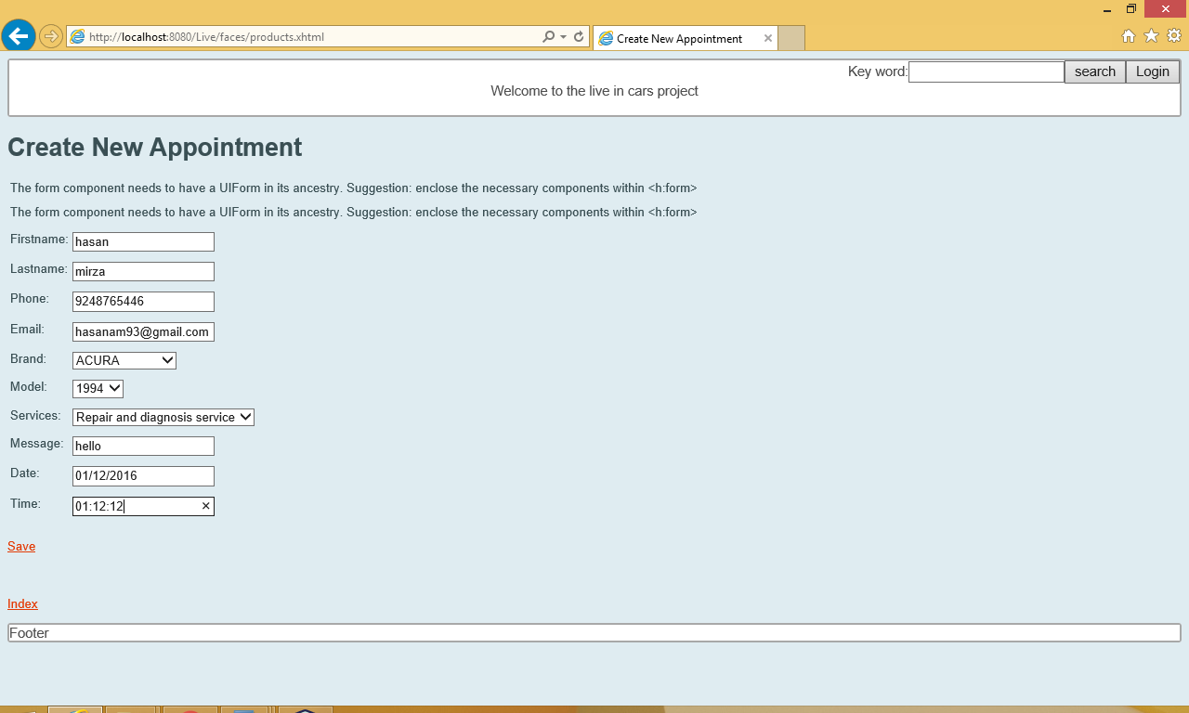
Make an appointment
Now, this is the most important module and also functionality of our application. Our whole idea moves around this concept. Once logged in, a user can schedule an appointment with the management. He will mention all his service needs in the space provided. Once, he schedules this, admin to look it on his side and take actions accordingly. This is the business behind this application.

Slide 24
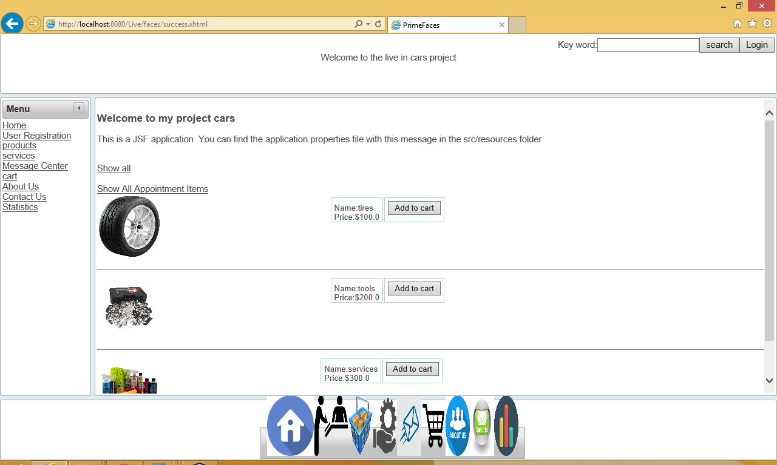
products
This is one of the important modules in our application. This is also major business tool for the management. Here, we list out all kinds of products available in our warehouse. A logged in customer can view the complete and purchase later on.

Slide 25
services
In this we describe our service packages. Here, a logged in user can look at different services we provide. According to his requirement, he can look for specific service. Now, there he can write down in appointment page and get his job done. Simple, but useful module.

Slide 26
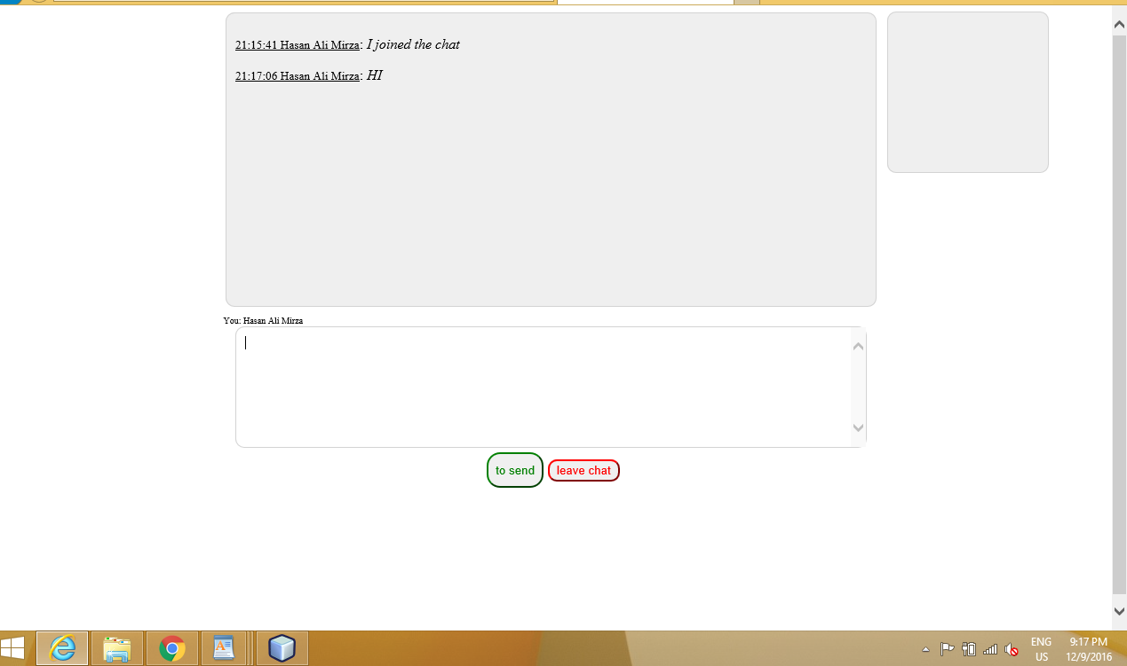
Message center
This part is very useful from customer point of view. While, shopping or figuring out his service option, a logged in user can go to message center and communicate instantly with admin.

Slide 27
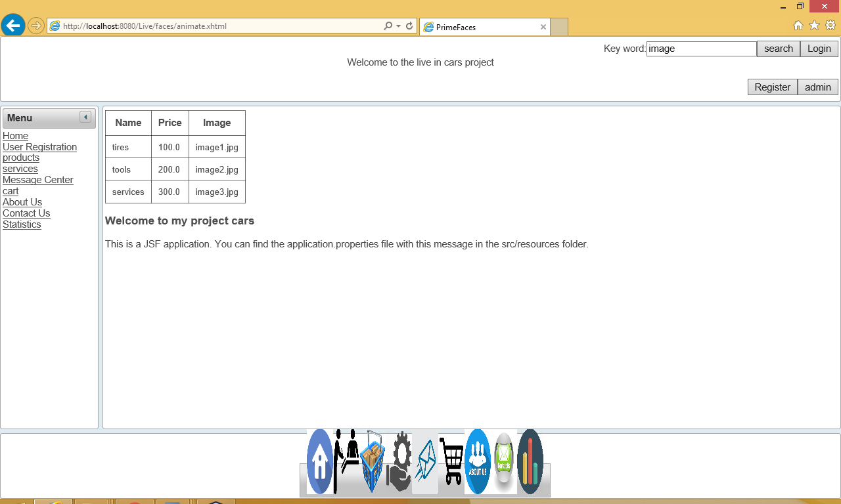
search
This a simple box space provided at the right corner. A user can type the specific product he is look for. Once, it gets matched he will get directed to that particular page.

Slide 28
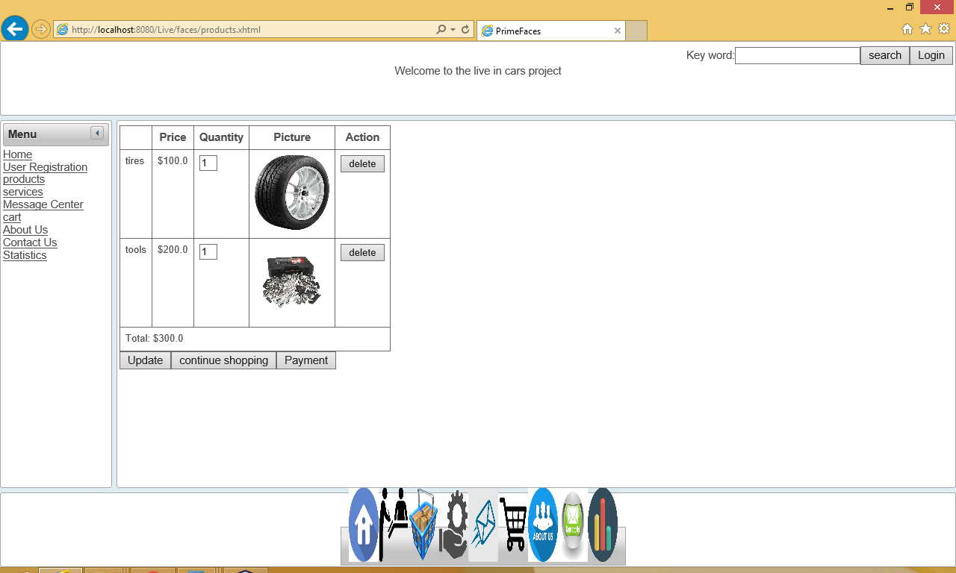
cart
Name of this module defines everything. A user can add all his shopped products to this cart. User can add and delete selected products from cart. Once he is done with finalizing cart, he can go ahead for payment

Slide 29
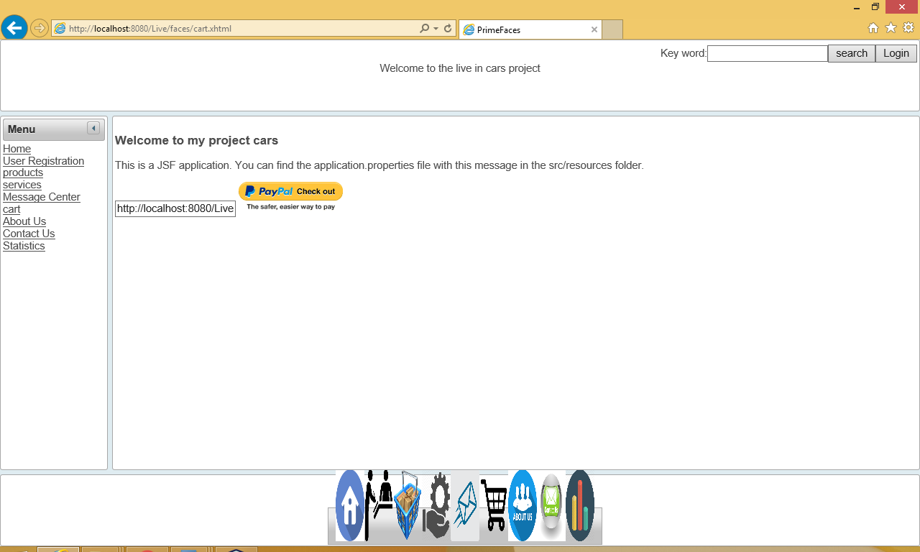
payment
This module comes only after finalization of cart. Once, user finalizes cart he can head to payment modules. There he can pay with cards or PayPal and purchase his products.

Slide 30
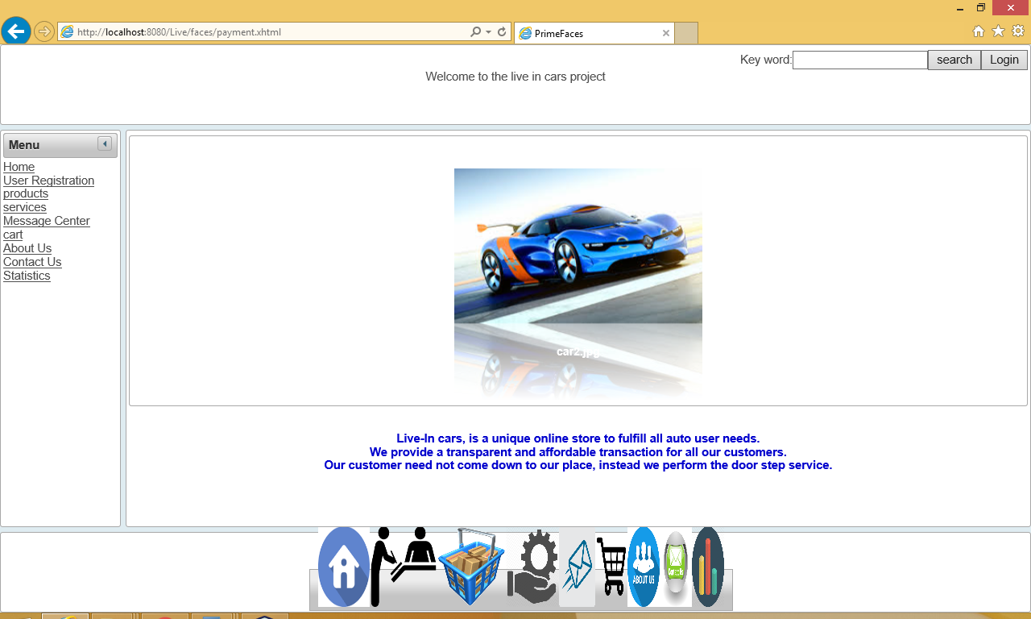
About us
This is informative part of our application. A small and simple description of basic functions of our application will be presented.

Slide 31
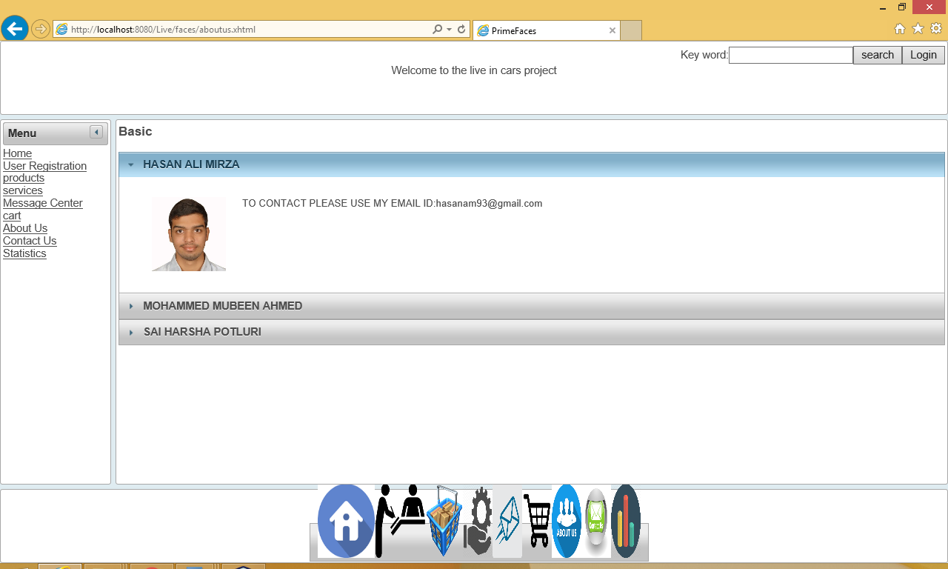
Contact us
Name says it all. Complete contact details of management will be provided here. User can view and contact the management accordingly.

Slide 32
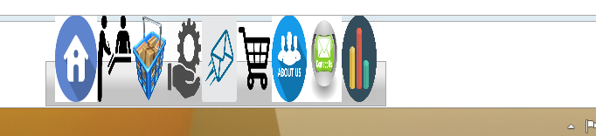
docks
It is an attractive bar kind of thing. This goes into to footer. User can easily navigate to all modules using these Docks. All thanks to prime faces.

Slide 33
conclusion
Well, after implementing this application. We can strongly say future of auto needs can be innovated. We don’t say that, here everything has been addressed and innovated. But, form now can look at things differently. Orthodox methods can be answered with modern solutions. Technology can address all issues. There cannot be a particular to solution to all problems. The solution set will change with the time. So, updating yourself and grabbing the market was the major idea behind this application.

Slide 34
references
http://www.primefaces.org/showcase/
http://www.youtube.com/jsftutorials
https://www.youtube.com/results?search_query=mastering+primefaces+tutorial

